Slide 1

EMBSYS 105 Programming with Embedded & Real-Time Operating Systems
Instructor: Nick Strathy, nstrathy@uw.edu
TA: Gideon Lee, gideonhlee@yahoo.com
© N. Strathy 2020
Lecture 9 3/9/2020

Slide 2
Looking ahead
Date | Lecture number | Assignment
1/6 | L1 | A1 due* before L2
1/13 | L2 | A2 due before L3
1/20 | L3 | A3 due before L4
1/27 | L4 | A4 due before L5
2/3 | L5 | A5 due before L7, Project due before L10
2/10 | L6
2/17 | Holiday – enjoy!
2/24 | L7
3/2 | L8, Guest Lecture: Bill Lamie (CEO) & Yuxin Zhou VP Eng of Express Logic
3/9 | L9
3/16 | L10 – Student presentations
* Assignments are due Sunday night at 11:59 PM

Slide 3
Previous Lecture (L8) Overview
Project documentation
Increasing clock rate on STM32F401RE
Add a command shell to a multithreading app
Findings of an embedded survey
Guest lecture Bill Lamie, Yuxin Zhou
SD Card protocol
Continue here

Slide 4
Last week’s guest lecture
Bill Lamie
blamie@expresslogic.com
Yuxin Zhou
yuxzho@microsoft.com
Lecture slides are on Canvas
Azure_RTOS_03-05-2020.pptx

Slide 5
Current Lecture (L9) Overview
SD Card protocol
Linker configuration file (.icf)
Additional embedded survey links
Interrupt driven touch: configuring STM32F401RE/FT6206
More embedded tools
Soldering iron
Multimeter
Logic analyzer

Slide 6
Get ready!
Student Presentations next week
2-4 minutes
Slides – your features, design, RTOS services used
Demo! (optional)
Submit your video to the “Video Upload” Assignment

Slide 7
IAR Linker configuration file
Specifies memory map for linker
Project Options->Linker->Config->Linker-Configuration-File
Default:
$TOOLKIT_DIR$\config\linker\ST\stm32f401xE.icf
"C:\Program Files (x86)\IAR Systems\Embedded Workbench 8.0\arm\config\linker\ST\stm32f401xE.icf“
IAR Reference:
EWARM->Help->C/C++ Development Guide

Slide 8
IAR Linker configuration file
Take a look at stm32f401xE.icf
/*###ICF### Section handled by ICF editor, don't touch! ****/
/*-Editor annotation file-*/
/* IcfEditorFile="$TOOLKIT_DIR$\config\ide\IcfEditor\cortex_v1_0.xml" */
/*-Specials-*/
define symbol __ICFEDIT_intvec_start__ = 0x08000000;
/*-Memory Regions-*/
define symbol __ICFEDIT_region_ROM_start__ = 0x08000000;
define symbol __ICFEDIT_region_ROM_end__ = 0x0807FFFF;
define symbol __ICFEDIT_region_RAM_start__ = 0x20000000;
define symbol __ICFEDIT_region_RAM_end__ = 0x20017FFF;
/*-Sizes-*/
define symbol __ICFEDIT_size_cstack__ = 0x2000;
define symbol __ICFEDIT_size_heap__ = 0x2000;
/**** End of ICF editor section. ###ICF###*/
Generated by IAR
Location of Interrupt Vector
Memory regions
specific to our board
Stack and heap size.
Stack larger than we need.
Heap larger than we need.

Slide 9
IAR Linker configuration file
define memory mem with size = 4G;
define region ROM_region = mem:[from __ICFEDIT_region_ROM_start__ to __ICFEDIT_region_ROM_end__];
define region RAM_region = mem:[from __ICFEDIT_region_RAM_start__ to __ICFEDIT_region_RAM_end__];
define block CSTACK with alignment = 8, size = __ICFEDIT_size_cstack__ { };
define block HEAP with alignment = 8, size = __ICFEDIT_size_heap__ { };
initialize by copy { readwrite };
do not initialize { section .noinit };
place at address mem:__ICFEDIT_intvec_start__ { readonly section .intvec };
place in ROM_region { readonly };
place in RAM_region { readwrite,
block CSTACK, block HEAP };
Define regions
Define blocks
Place Interrupt Vector in ROM.
See startup.s for .intvec
Items with attribute readonly to be placed in ROM_region.
Items with attribute readwrite to be place in RAM_region.

Slide 10
IAR Linker configuration file
Look at startup.s
; Create a data section to hold the Vector table addresses
; it is called .intvec, it contains DATA
; ROOT determines if the linker will include the section even if it is not used
; NOROOT will cause the linker to discard unused sections
; the alignment is (2) which means 2 ^ 2, AKA 32 bit alignment
; NOTE: .intvec is a convention for the section with the interrupt vector:
SECTION .intvec:CODE:ROOT(2)
.intvec corresponds to .intvec in the
Linker config file

Slide 11
Additional Embedded Surveys
https://m.eet.com/media/1246048/2017-embedded-market-study.pdf
https://www.embedded.com/2019-embedded-markets-study-reflects-emerging-technologies-continued-c-c-dominance/
https://www.embedded.com/wp-content/uploads/2019/11/EETimes_Embedded_2019_Embedded_Markets_Study.pdf

Slide 12
Interrupt driven touch
See Canvas file InterruptTouch.zip
Requires soldering (unfortunately)
Involves
Connecting the IRQ output signal of the touch panel to a GPIO on the Nucleo
Configuring the GPIO port
Configuring an EXTI line to use the GPIO as an interrupt input
Adding an IRQ handler for the EXTI events
Modifying the existing touch polling loop to pend until the IRQ handler provides a touch point.

Slide 13
Interrupt driven touch
1. Determine which pinout from the touch panel is the interrupt (IRQ):
According to the Adafruit document:
Solder jumper "TS Int" to jumper #7 to access the interrupt signal on pin D7 (PA8 Nucleo)
PROBLEM:
CONFLICT!: Adafruit Music Maker Shield uses D7 for MCS (Command interface chip select)!
NOTICE THAT:
We can solder a wire from jumper #7 to jumper #5:
good news!: D5/PB4 is not already in use.
So we can take the IRQ from the touch panel on D5 as input to PB4

Slide 14
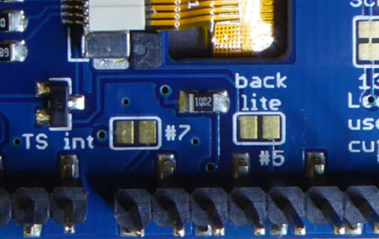
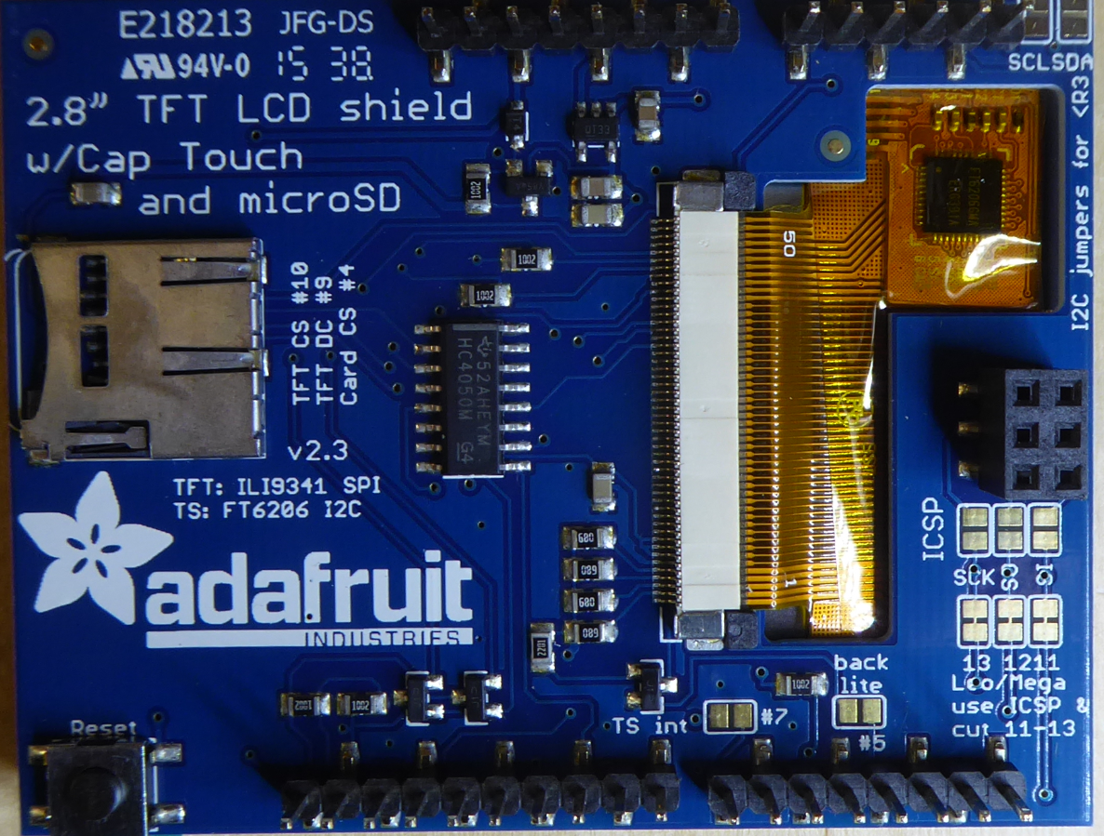
Interrupt driven touch
We can solder TS int to #5 since D5 is not being used and we don’t need external back light control.
TS int - #7 jumper can’t be used since D7 is already being used by Music Maker shield

Slide 15
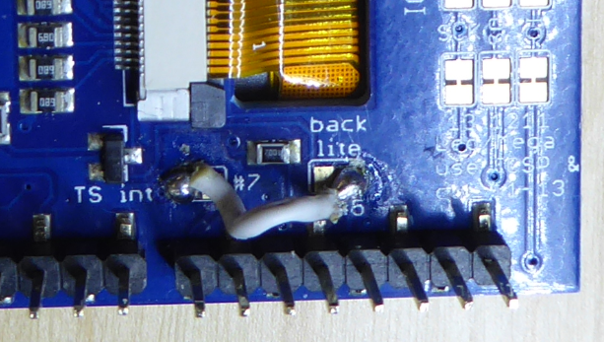
Interrupt driven touch
Solder a small length of wire from jumper “TS int” to jumper #5

Slide 16
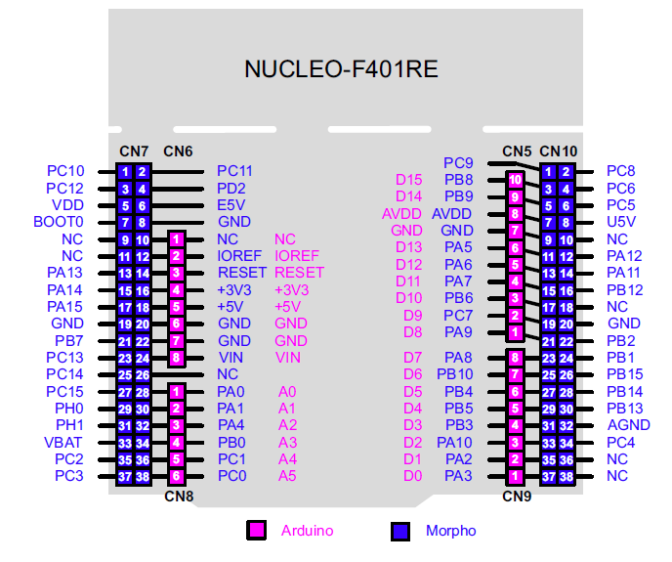
Interrupt driven touch
After soldering jumper “TS int” to jumper #5 we can capture the touch interrupt on Arduino D5 / Morpho PB4

Slide 17
Interrupt driven touch
Look at Readme.txt (from InterruptTouch.zip)
Demo interrupt driven touch

Slide 18
More embedded tools
A soldering iron is handy for
Connecting jumpers
Connecting headers
Show a soldering iron and solder
Multimeter is handy for determining voltages
Voltage demo of last year’s touch shield vs this year’s
Observe voltage differences between the schematics
Observe different voltages on I2C SDA-PB9
Observe voltage on multi-touch

Slide 19
More embedded tools
Logic analyzer
Similar to an oscilloscope but not as sophisticated
Consists of a nest of probe wires to connect to pinouts
Records the signal activity on the probes for analysis
Demo of a simple Logic Analyzer with 4 probes
Maximum sample rate is 12 MHz
Given the Nyquist limit we should be able to get reliable samples for signals up to 6 MHz.

Slide 20
I2C logic analyzer demo
Application: basic MP3 skeleton with touch working
Configure Saleae Logic for I2C protocol
Configure trigger on Probe0 (SDA) falling
Connect probes:
SCL – PB8 : Probe1
SDA – PB9 : Probe0
GND : GND Probe
Run application
Demo 1: Record for 1 second without touching the screen:
Observe
touched() transaction
Write 2 (i.e. desired touch register)
Read contents of register 2 (i.e. number of touches)
Result is 0 (no touch)

Slide 21
Demo 1: Record for 1 second without touching the screen continued
Observe
Frequency of clock signal
Interval between Touched() calls
Demo 2: Record for 1 second while touching screen
Observe:
touched() transaction
Write 2 (i.e. desired touch register)
Read contents of register 2 (i.e. number of touches)
Result is 1 touch
getPoint() transaction
Write 0 (i.e. desired touch register)
Read 16 registers beginning at register 0

Slide 22
SPI logic analyzer demo
Application: a basic MP3 app that adds reading from SD
Demo 3: MP3 streaming
Connect probes
SCK PA5 : Probe2
MISO PA6 : Probe1
MOSI PA7 : Probe0
DREQ PB3 : Probe3
Configure trigger on DREQ rising (MP3 requesting data)
Record for 1 second
Observe:
SCK shows data transmission in 32-byte chunks to the decoder chip as expected

Slide 23
SPI logic analyzer demo
Demo 3: MP3 streaming (continued)
Observe:
Interval between DREQ high events
Demo 4: SD Reading
Connect probes
Probes 0-2 as before
SD CS PB5: Probe3
Configure trigger on Probe3 falling
Record for 1 second
Observe:
Infrequent short bursts of reading from SD

